Slide 1
1
Last Session :
Happy and On Fire !!!

Slide 2
2
We start
from the ZERO

Slide 3
3
Don’t feeling left behind
you are going at your own pace

Slide 4
FUNDAMENTAL
PYTHON
DATA
SCIENCE
FUNDAMENTAL
SQL
DATA
VISUALIZATION
PORTFOLIO
SESSION

Slide 5
Query Join
Sesi 5 - Bootcamp Data Analyst with SQL and Python using Google Platform

Slide 6

Fundamental SQL Menggunakan Google Big Query
DDL : Create, Drop
Query Select and combination
DML : Insert, Update, Delete
Query Date, Subquery and Case When
Query Join

Slide 7
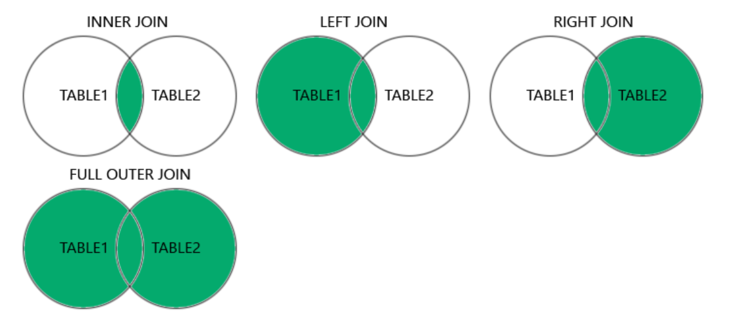
QUERY JOIN

Slide 8
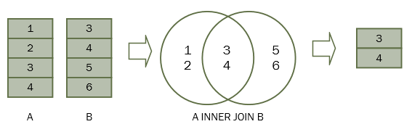

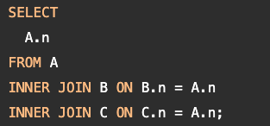
SQL INNER JOIN

Slide 9
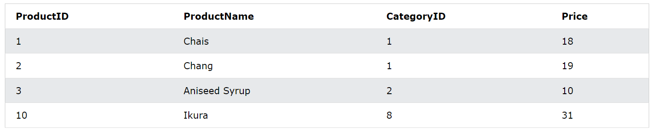
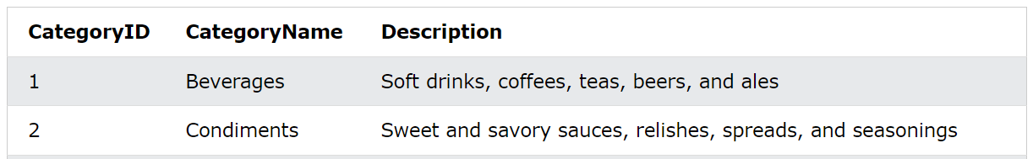
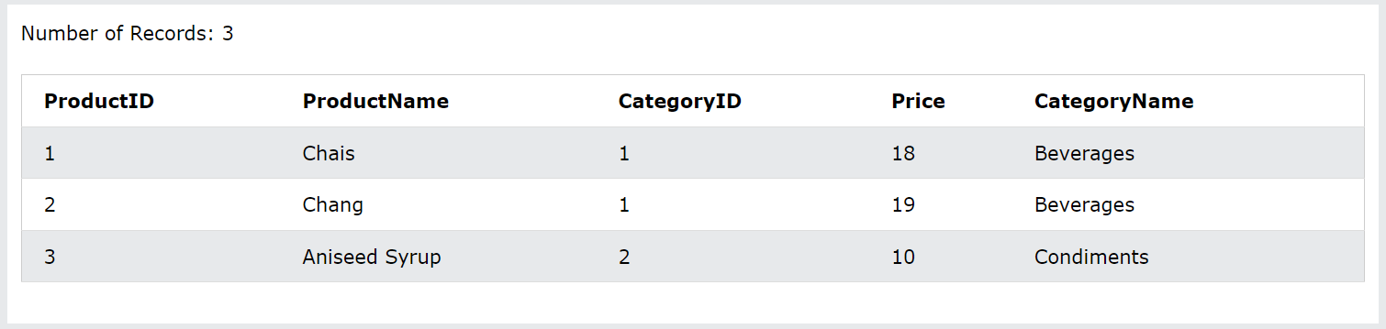
1
SELECT column_name(s) FROM table1 INNER JOIN table2 ON table1.column_name = table2.column_name
;
2
SELECT t1.ProductID, t1.ProductName
, t1.CategoryID, t1.Price
, t2.CategoryName FROM Products t1 INNER JOIN Categories t2
ON t1.CategoryID = t2.CategoryID
;
3

Slide 10
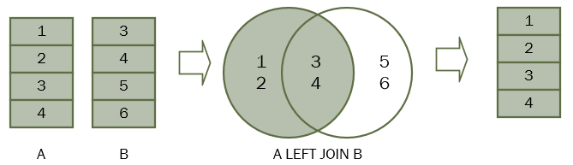
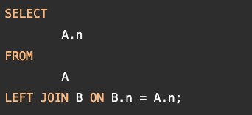
SQL LEFT/RIGHT JOIN
Right Join atau Left Join adalah hal yang sama, yaitu untuk mengembalikan semua baris dari tabel kiri/kanan dan mencari apakah ada baris yang cocok atau tidak di tabel sebaliknya. Saat kita menggabungkan tabel A dengan tabel B, semua baris pada tabel A (tabel kiri) dimasukkan ke dalam himpunan hasil apakah ada baris yang cocok pada tabel B atau tidak.
3
4
5
6
RIGHT JOIN

Slide 11
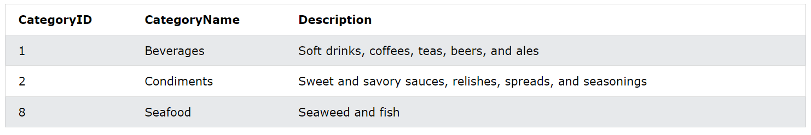
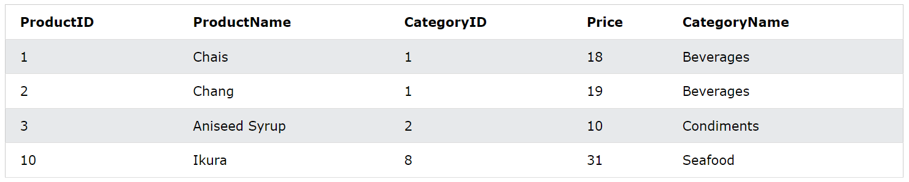
1
SELECT column_name(s) FROM table1 LEFT JOIN table2 ON table1.column_name = table2.column_name
;
2
SELECT t1.ProductID, t1.ProductName
, t1.CategoryID, t1.Price
, t2.CategoryName FROM Products t1 LEFT JOIN Categories t2
ON t1.CategoryID = t2.CategoryID
;
3

Slide 12
1
SELECT column_name(s) FROM table1 RIGHT JOIN table2 ON table1.column_name = table2.column_name
;
2
SELECT t1.ProductID, t1.ProductName
, t1.CategoryID, t1.Price
, t2.CategoryName FROM Products t1 RIGHT JOIN Categories t2
ON t1.CategoryID = t2.CategoryID
;
3

Slide 13
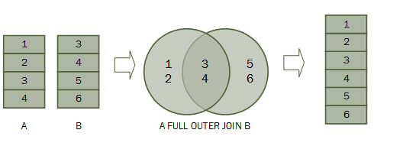

Secara teori, full outer join adalah kombinasi dari left join dan right join. Gabungan luar penuh mencakup semua baris dari tabel gabungan apakah tabel lain memiliki baris yang cocok atau tidak.
Jika baris dalam tabel gabungan tidak cocok, kumpulan hasil gabungan luar penuh berisi nilai NULL untuk setiap kolom tabel yang tidak memiliki bari yang cocok.

Slide 14
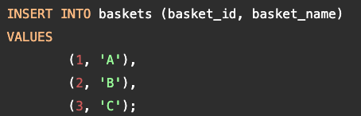
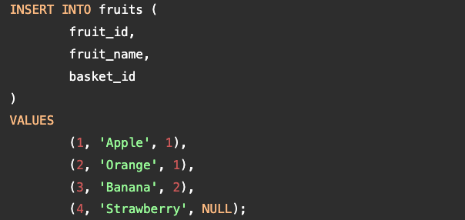
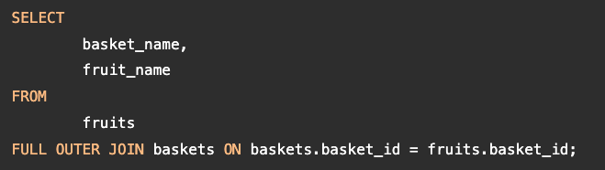
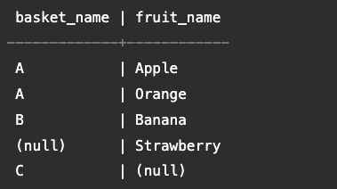
SQL FULL OUTER JOIN - Contoh
Pertama, buat dua tabel baru: keranjang dan buah untuk demonstrasi. Setiap keranjang menyimpan nol buah atau lebih dan setiap buah dapat disimpan dalam nol atau satu keranjang.
Untuk menggabungkan data dari kedua tabel ini, Anda menggunakan klausa gabungan dalam sebagai query berikut:

Slide 15
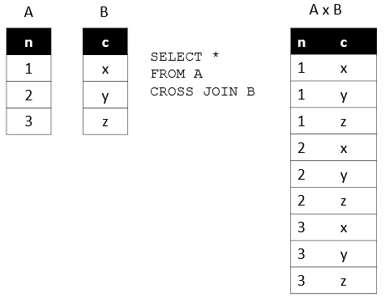

SQL CROSS JOIN
Cross join adalah operasi join yang menghasilkan produk Cartesian dari dua tabel atau lebih. Dalam Matematika, produk Cartesian adalah operasi matematika yang mengembalikan rangkaian produk dari beberapa rangkaian.

Slide 16
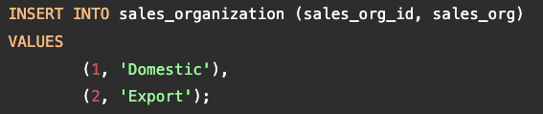
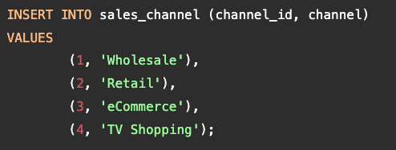
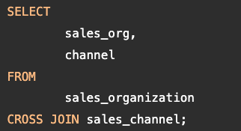
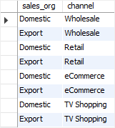
SQL CROSS JOIN - Contoh
Misalkan perusahaan memiliki dua organisasi penjualan yaitu Domestik dan Ekspor, yang bertanggung jawab atas penjualan di pasar domestik dan internasional.
Untuk menemukan semua saluran penjualan yang mungkin dimiliki organisasi penjualan, Anda menggunakan CROSS JOIN untuk menggabungkan tabel sales_organization dengan tabel sales_channel sbb :

Slide 17





Fundamental SQL Menggunakan Google Big Query
DDL : Create, Drop
Query Select and combination
DML : Insert, Update, Delete
Query Date, Subquery and Case When
Query Join

Slide 18
CURIOSITY
+
PASSIONATE
READY !!!

Slide 19

Let’s Review
Together

Slide 20
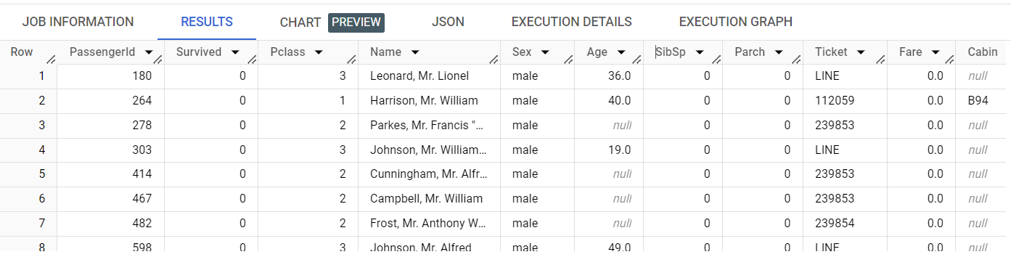
Dataset : Titanic Passenger
Value
Atribut/
Field/
Column
Record/
Row
Entity

Slide 21

Let’s Prepare
the Table first !

Slide 22
Create Customer Profile Table
drop table if exists `bootcamp-402414.data_analytic.customer_profile`;
create table `bootcamp-402414.data_analytic.customer_profile` as
select customer_id, customer_name, postal_code, product_id, order_date, ship_date
from `bootcamp-402414.data_analytic.super_store`
;
select * from `bootcamp-402414.data_analytic.customer_profile` ;

Slide 23
Create Customer Location Table
drop table if exists `bootcamp-402414.data_analytic.customer_location`;
create table `bootcamp-402414.data_analytic.customer_location` as
select postal_code, city, state, country_region, region
from `bootcamp-402414.data_analytic.super_store`
group by 1,2,3,4,5
;
select * from `bootcamp-402414.data_analytic.customer_location` ;

Slide 24
Create Product Catalog Table
drop table if exists `bootcamp-402414.data_analytic.product_catalog`;
create table `bootcamp-402414.data_analytic.product_catalog` as
select product_id, category, sub_category, product_name
from `bootcamp-402414.data_analytic.super_store`
group by 1,2,3,4
;
select * from `bootcamp-402414.data_analytic.product_catalog` ;

Slide 25
Create Customer Segment Table
drop table if exists `bootcamp-402414.data_analytic.customer_segment`;
create table `bootcamp-402414.data_analytic.customer_segment` as
select customer_name, segment
from `bootcamp-402414.data_analytic.super_store`
group by 1,2
;
select * from `bootcamp-402414.data_analytic.customer_segment` ;

Slide 26

Let’s Explore
The Data !

Slide 27
Query SELECT and WHERE + SORTING
select * from `bootcamp-402414.data_analytic.product_catalog` ;
select distinct sub_category from `bootcamp-402414.data_analytic.product_catalog` ;
select distinct sub_category from `bootcamp-402414.data_analytic.product_catalog`
order by sub_category asc ;
select * from `bootcamp-402414.data_analytic.product_catalog`
WHERE SUB_CATEGORY = 'Art' ;

Slide 28
Query SELECT and WHERE + SORTING
select * from `bootcamp-402414.data_analytic.customer_profile` ;
select * from `bootcamp-402414.data_analytic.customer_profile`
where order_date = date '2017-08-30’
select * from `bootcamp-402414.data_analytic.customer_profile`
where order_date < date '2017-08-30' ;
select * from `bootcamp-402414.data_analytic.customer_profile`
where product_id like '%OFF%’ ;
select * from `bootcamp-402414.data_analytic.customer_profile`
where product_id not like '%OFF%' ;

Slide 29
Query AGGREGATION + HAVING
select order_date
, count(*) as total_trx
from `bootcamp-402414.data_analytic.customer_profile`
where product_id like '%OFF%' and order_date > date '2017-08-30'
group by order_date
order by order_date asc;
select order_date
, count(*) as total_trx
from `bootcamp-402414.data_analytic.customer_profile`
where product_id like '%OFF%' and order_date > date '2017-08-30'
group by order_date
having total_trx > 10
order by order_date asc ;

Slide 30
Query FUNCTION DATE_ADD + DATE_DIFF
select customer_id
, product_id
, order_date
, ship_date
, DATE_ADD(ship_date, INTERVAL 10 DAY) AS ten_days_later_from_ship_date
, DATE_ADD(ship_date, INTERVAL 2 MONTH) AS two_months_later_from_ship_date
, DATE_ADD(ship_date, INTERVAL 1 YEAR) AS a_year_later_from_ship_date
, DATE_DIFF(ship_date, order_date, DAY) AS days_diff
FROM `bootcamp-402414.data_analytic.customer_profile` ;

Slide 31
Query FUNCTION DATE_SUB + DATE_DIFF
select customer_id
, product_id
, order_date
, ship_date
, DATE_SUB(ship_date, INTERVAL 10 DAY) AS ten_days_back_from_ship_date
, DATE_SUB(ship_date, INTERVAL 2 MONTH) AS two_months_back_from_ship_date
, DATE_SUB(ship_date, INTERVAL 1 YEAR) AS a_year_back_from_ship_date
, DATE_DIFF(ship_date, order_date, DAY) AS days_diff
, DATE_DIFF(ship_date, order_date, WEEK) AS days_diff
FROM `bootcamp-402414.data_analytic.customer_profile` ;

Slide 32
Query FUNCTION EXTRACT DATE
SELECT customer_id
, ship_date
, extract(DAY from ship_date) as ship_date_day
, extract(WEEK from ship_date) as ship_date_WEEK
, extract(MONTH from ship_date) as ship_date_MONTH
, extract(YEAR from ship_date) as ship_date_YEAR
FROM `bootcamp-402414.data_analytic.customer_profile`
limit 10 ;

Slide 33
Query LEFT JOIN (1)
select * from `bootcamp-402414.data_analytic.product_catalog`
;
select t1.*, t2.category, t2.sub_category, t2.product_name
from `bootcamp-402414.data_analytic.customer_profile` t1
left join `bootcamp-402414.data_analytic.product_catalog` t2
on t1.product_id = t2.product_id
;

Slide 34
Query LEFT JOIN (2)
select * from `bootcamp-402414.data_analytic.customer_location` ;
select t1.*, t2.city, t2.state, t2.country_region, t2.region
from `bootcamp-402414.data_analytic.customer_profile` t1
left join `bootcamp-402414.data_analytic.customer_location` t2
on t1.postal_code = t2.postal_code
;

Slide 35
Query LEFT JOIN (3)
select t1.*
, t2.category, t2.sub_category, t2.product_name
, t3.city, t3.state, t3.country_region, t3.region
, t4.segment
from `bootcamp-402414.data_analytic.customer_profile` t1
left join `bootcamp-402414.data_analytic.product_catalog` t2 on t1.product_id = t2.product_id
left join `bootcamp-402414.data_analytic.customer_location` t3 on t1.postal_code = t3.postal_code
left join `bootcamp-402414.data_analytic.customer_segment` t4 on t1.customer_name = t4.customer_name
;

Slide 36
Query INNER JOIN
select t1.customer_id, t1.customer_name, t2.segment
from `bootcamp-402414.data_analytic.customer_profile` t1
left join `bootcamp-402414.data_analytic.customer_segment` t2
on t1.customer_name = t2.customer_name
;
select t1.customer_id, t1.customer_name, t2.segment
from `bootcamp-402414.data_analytic.customer_profile` t1
inner join
(select * from `bootcamp-402414.data_analytic.customer_segment`
where segment = 'Consumer') t2
on t1.customer_name = t2.customer_name
;

Slide 37
Query CROSS JOIN
select * from
(
select distinct customer_name
from `bootcamp-402414.data_analytic.customer_profile`
where customer_name in ('Annie Thurman','Ben Ferrer','Henry Goldwyn')
) t0
cross join
(
select distinct product_id
from `bootcamp-402414.data_analytic.customer_profile`
where product_id in ('OFF-BI-10002432','TEC-PH-10004447','OFF-BI-10000285')
) t1
;

Slide 38
It’s time to
QUIZ ☺

Slide 39

Congratulations
for the winner ☺

